Slide 1
High-Speed 16-Radix Polynomial Multiplication on ARM Cortex-M4 with Recursive Karatsuba Layers
Minjoo Sim, Hyunjun Kim, Minwoo Lee, Hwajeong Seo

Slide 2
Introduction
Background
Proposed Method
Evaluation
Conclusion

Slide 3
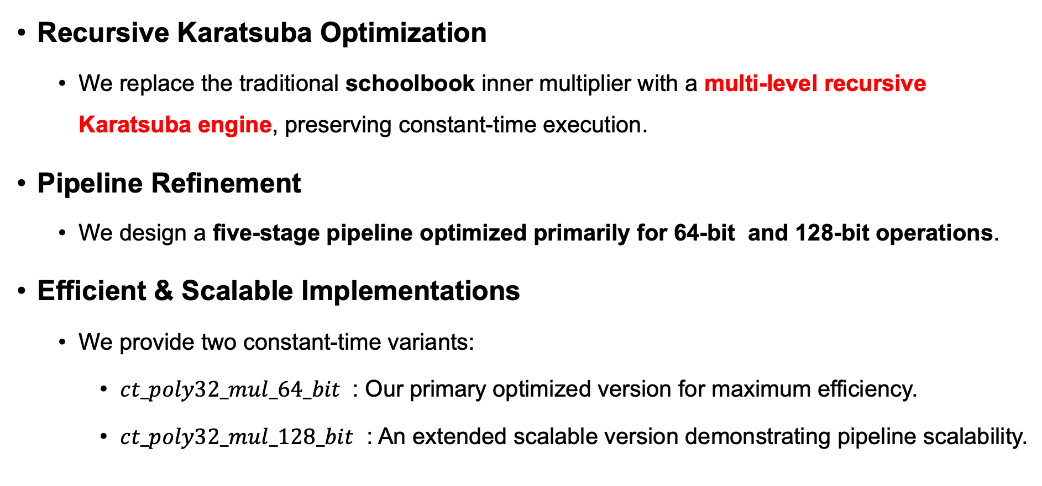
Contribution
Recursive Karatsuba Optimization
We replace the traditional schoolbook inner multiplier with a multi-level recursive Karatsuba engine, preserving constant-time execution.
Pipeline Refinement
We design a five-stage pipeline optimized primarily for 64-bit and 128-bit operations.
Efficient & Scalable Implementations
We provide two constant-time variants:
$ct_poly32_mul_64_bit$ : Our primary optimized version for maximum efficiency.
$ct_poly32_mul_128_bit$ : An extended scalable version demonstrating pipeline scalability.

Slide 4
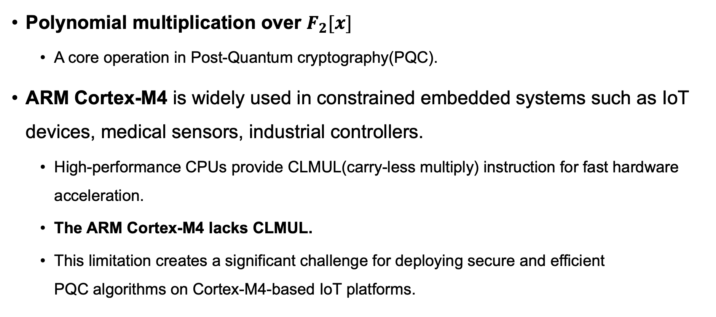
Introduction
Polynomial multiplication over $F_{2}[x]$
A core operation in Post-Quantum cryptography(PQC).
ARM Cortex-M4 is widely used in constrained embedded systems such as IoT devices, medical sensors, industrial controllers.
High-performance CPUs provide CLMUL(carry-less multiply) instruction for fast hardware acceleration.
The ARM Cortex-M4 lacks CLMUL.
This limitation creates a significant challenge for deploying secure and efficient PQC algorithms on Cortex-M4-based IoT platforms.

Slide 5
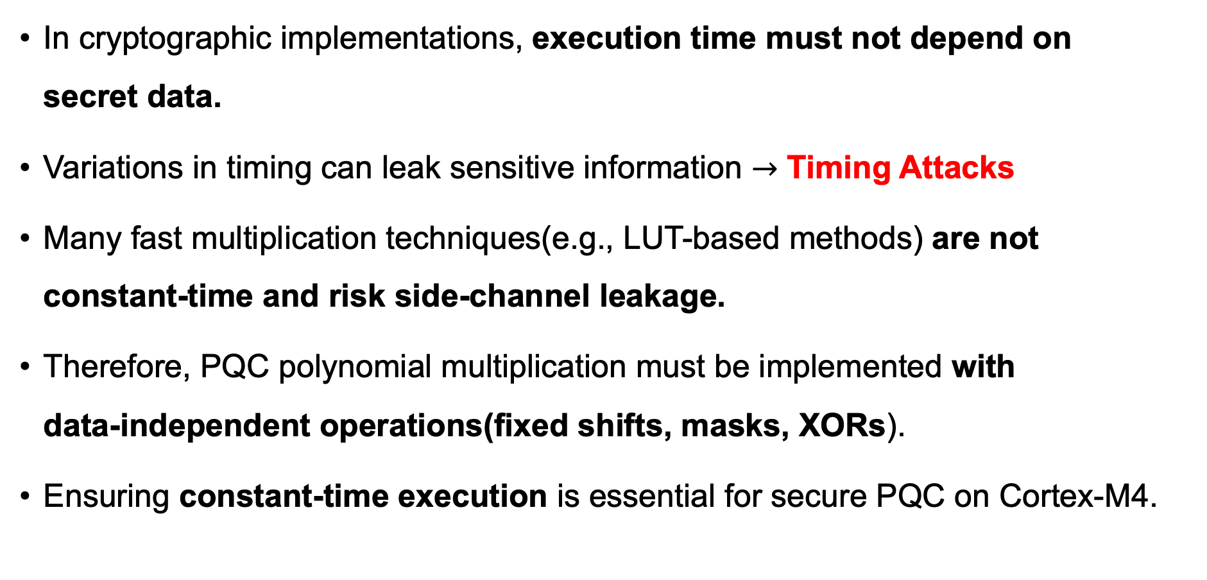
Background : Constant-Time Execution
In cryptographic implementations, execution time must not depend on secret data.
Variations in timing can leak sensitive information $→$ Timing Attacks
Many fast multiplication techniques(e.g., LUT-based methods) are not constant-time and risk side-channel leakage.
Therefore, PQC polynomial multiplication must be implemented with data-independent operations(fixed shifts, masks, XORs).
Ensuring constant-time execution is essential for secure PQC on Cortex-M4.

Slide 6
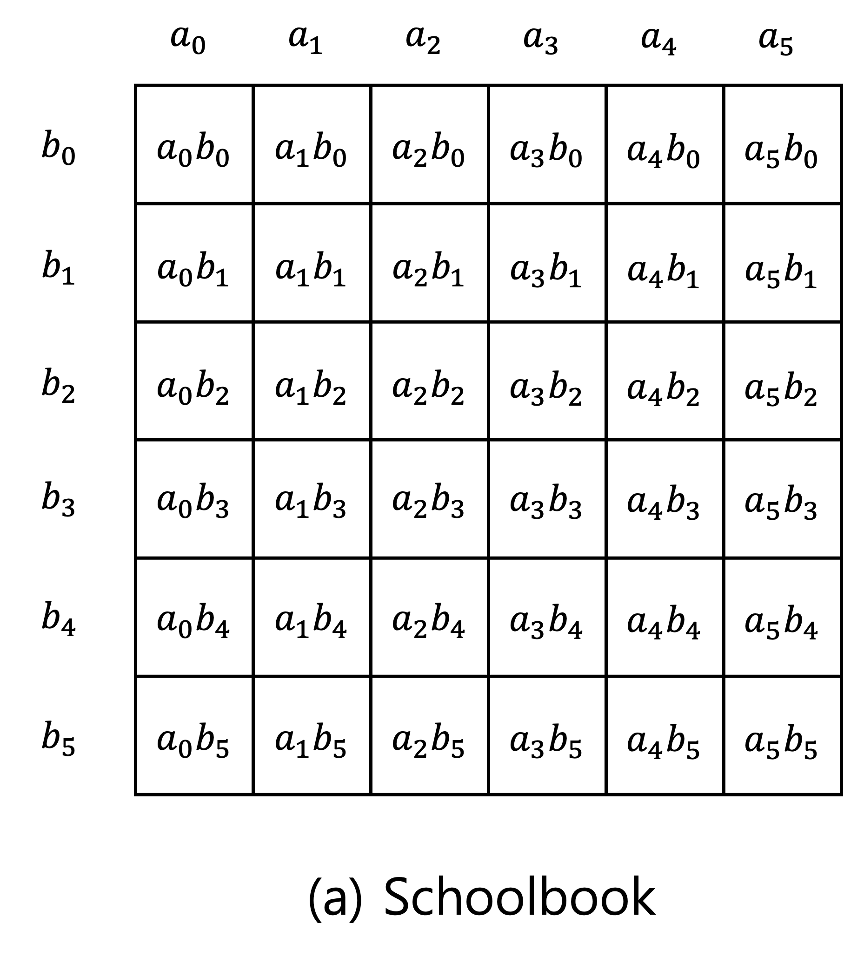
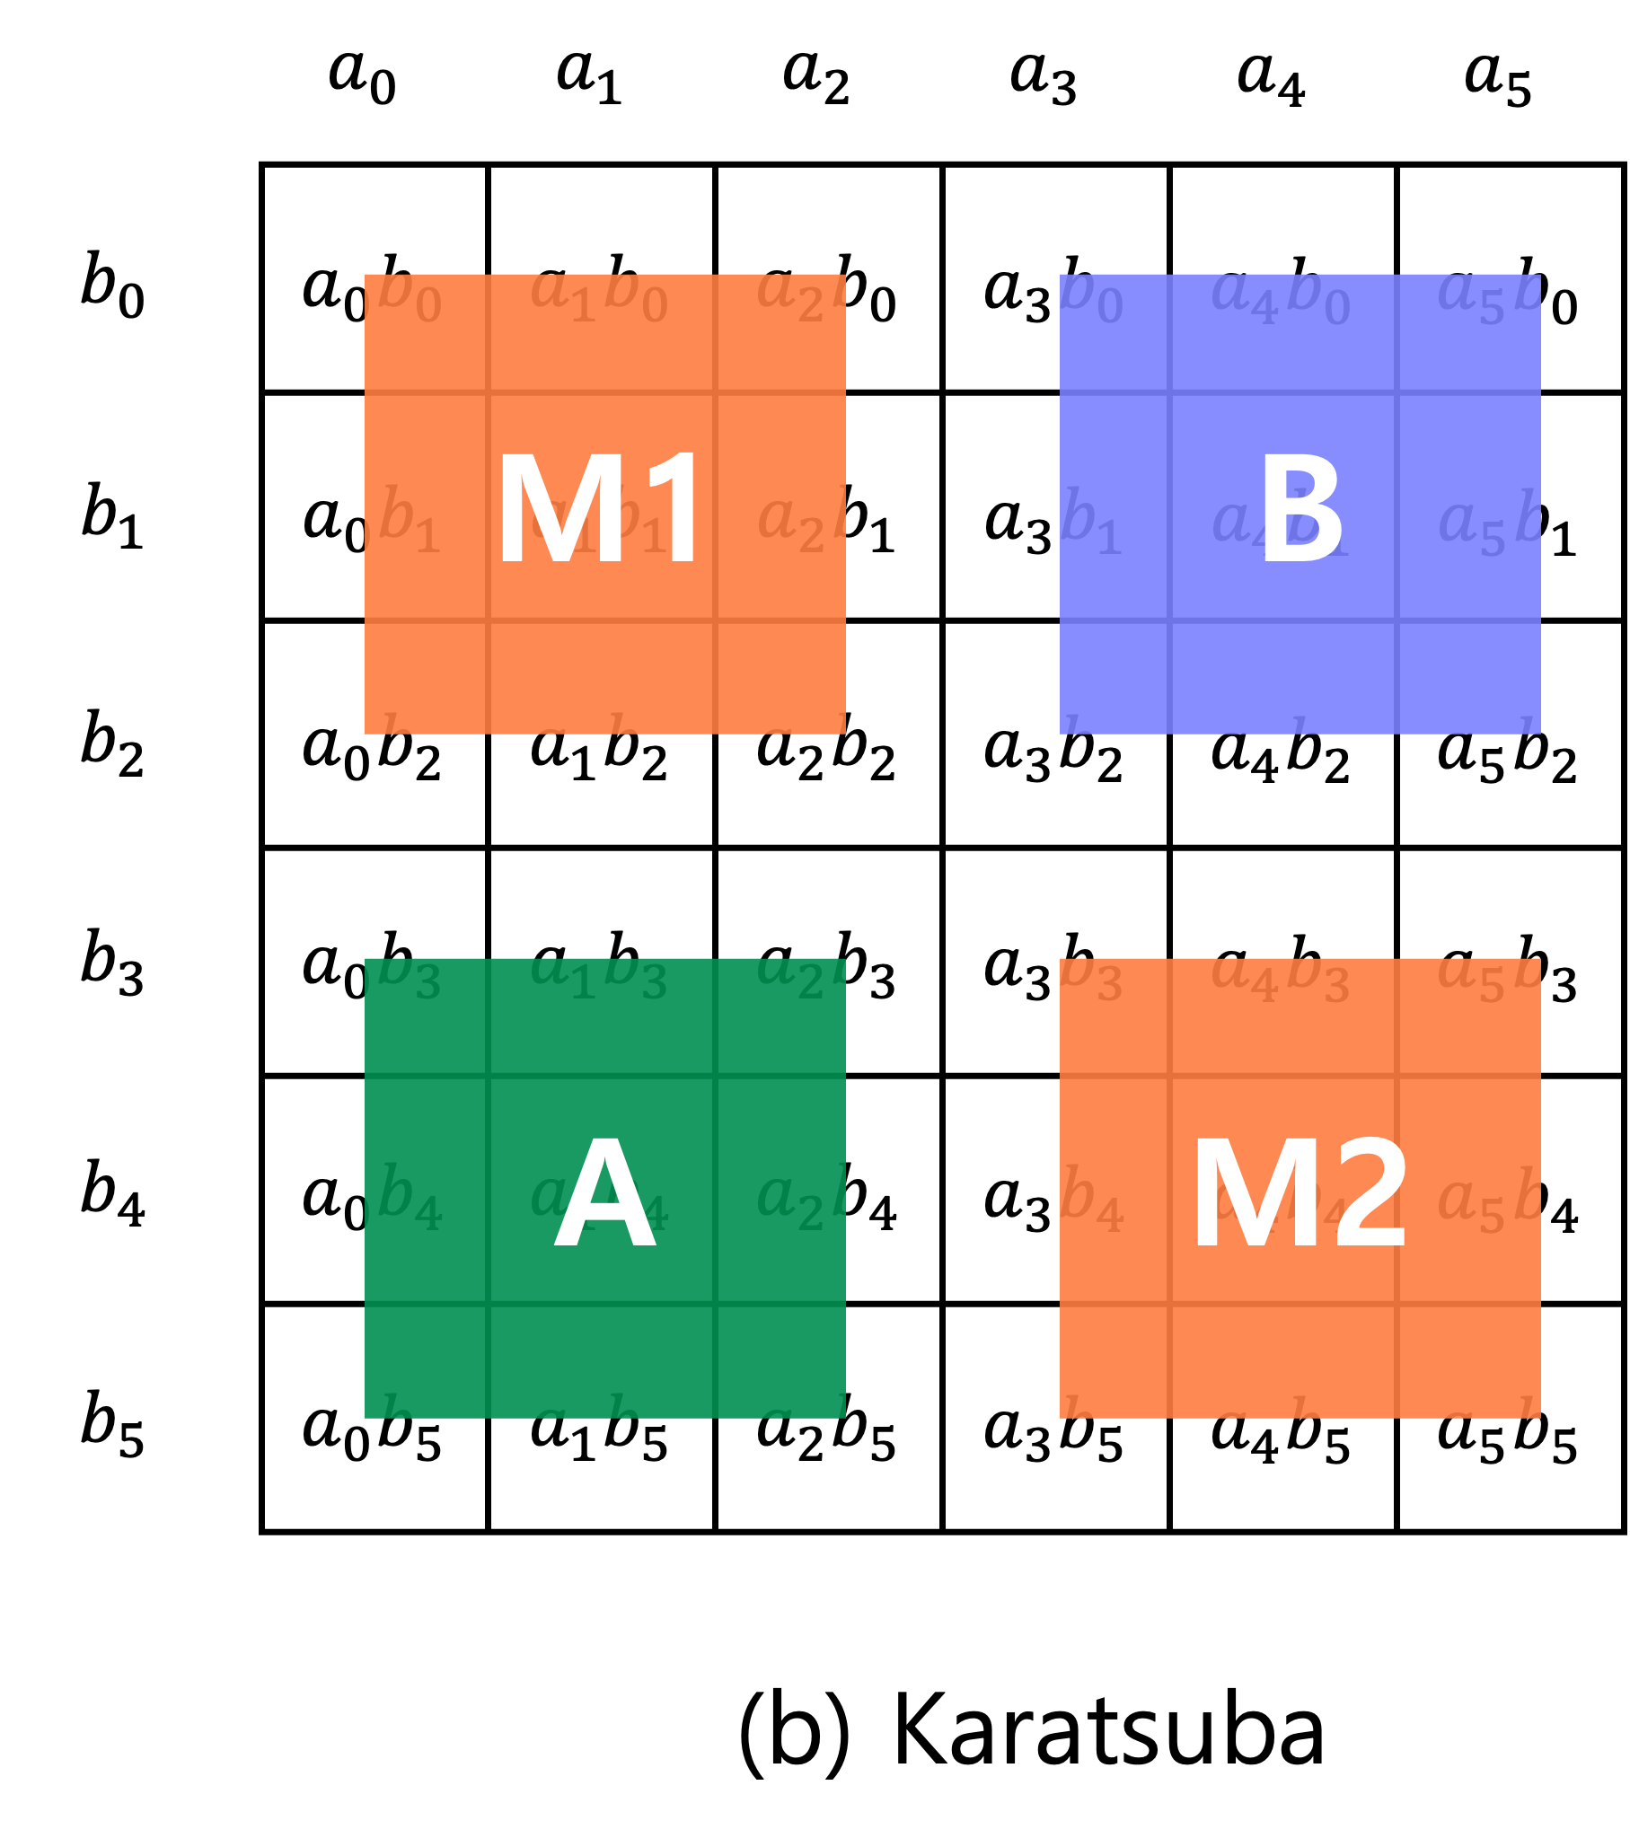
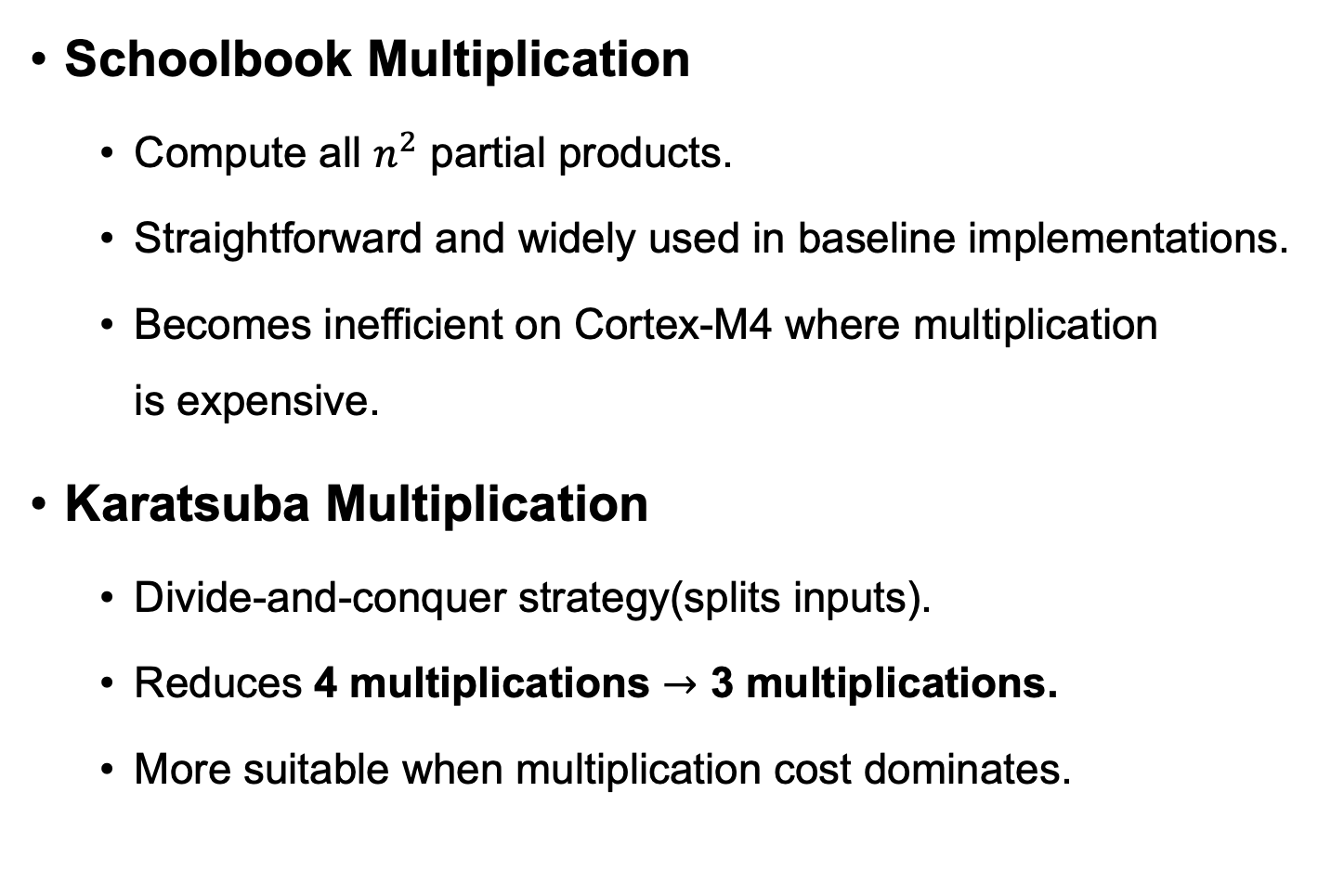
Background: Multiplication Algorithms
Schoolbook Multiplication
Compute all $n^{2}$ partial products.
Straightforward and widely used in baseline implementations.
Becomes inefficient on Cortex-M4 where multiplication is expensive.
Karatsuba Multiplication
Divide-and-conquer strategy(splits inputs).
Reduces 4 multiplications $→$ 3 multiplications.
More suitable when multiplication cost dominates.

Slide 7
Background: Multiplication Algorithms
Motivation for an Improved Multiplier
Multiplication becomes a major performance bottleneck in bit-sliced polynomial arithmetic.
Reducing multiplication count is therefore one of the most effective optimization approaches.
Karatsuba reduces the number of multiplications while naturally preserving constant-time behavior.

Slide 8
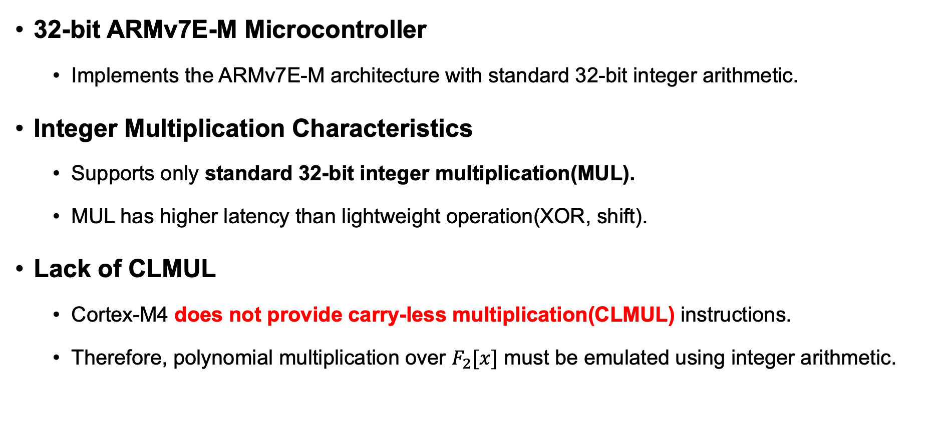
Background: ARM Cortex-M4
32-bit ARMv7E-M Microcontroller
Implements the ARMv7E-M architecture with standard 32-bit integer arithmetic.
Integer Multiplication Characteristics
Supports only standard 32-bit integer multiplication(MUL).
MUL has higher latency than lightweight operation(XOR, shift).
Lack of CLMUL
Cortex-M4 does not provide carry-less multiplication(CLMUL) instructions.
Therefore, polynomial multiplication over $F_{2}[x]$ must be emulated using integer arithmetic.

Slide 9
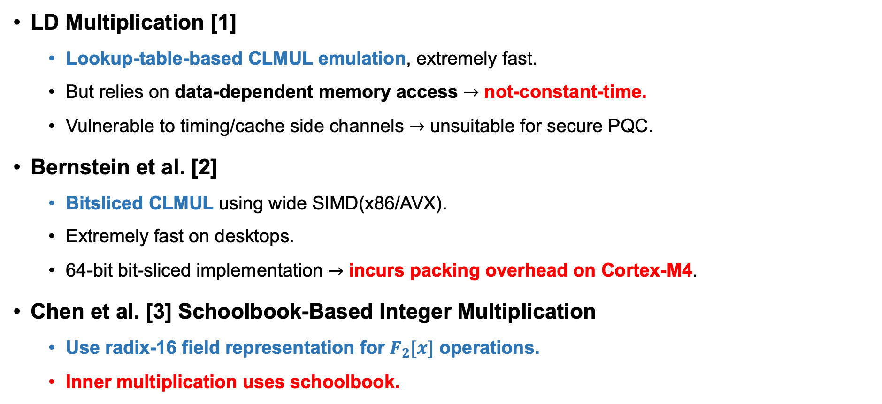
Related Work
LD Multiplication [1]
Lookup-table-based CLMUL emulation, extremely fast.
But relies on data-dependent memory access $→$ not-constant-time.
Vulnerable to timing/cache side channels $→$ unsuitable for secure PQC.
Bernstein et al. [2]
Bitsliced CLMUL using wide SIMD(x86/AVX).
Extremely fast on desktops.
64-bit bit-sliced implementation $→$ incurs packing overhead on Cortex-M4.
Chen et al. [3] Schoolbook-Based Integer Multiplication
Use radix-16 field representation for $F_{2}[x]$ operations.
Inner multiplication uses schoolbook.

Slide 10
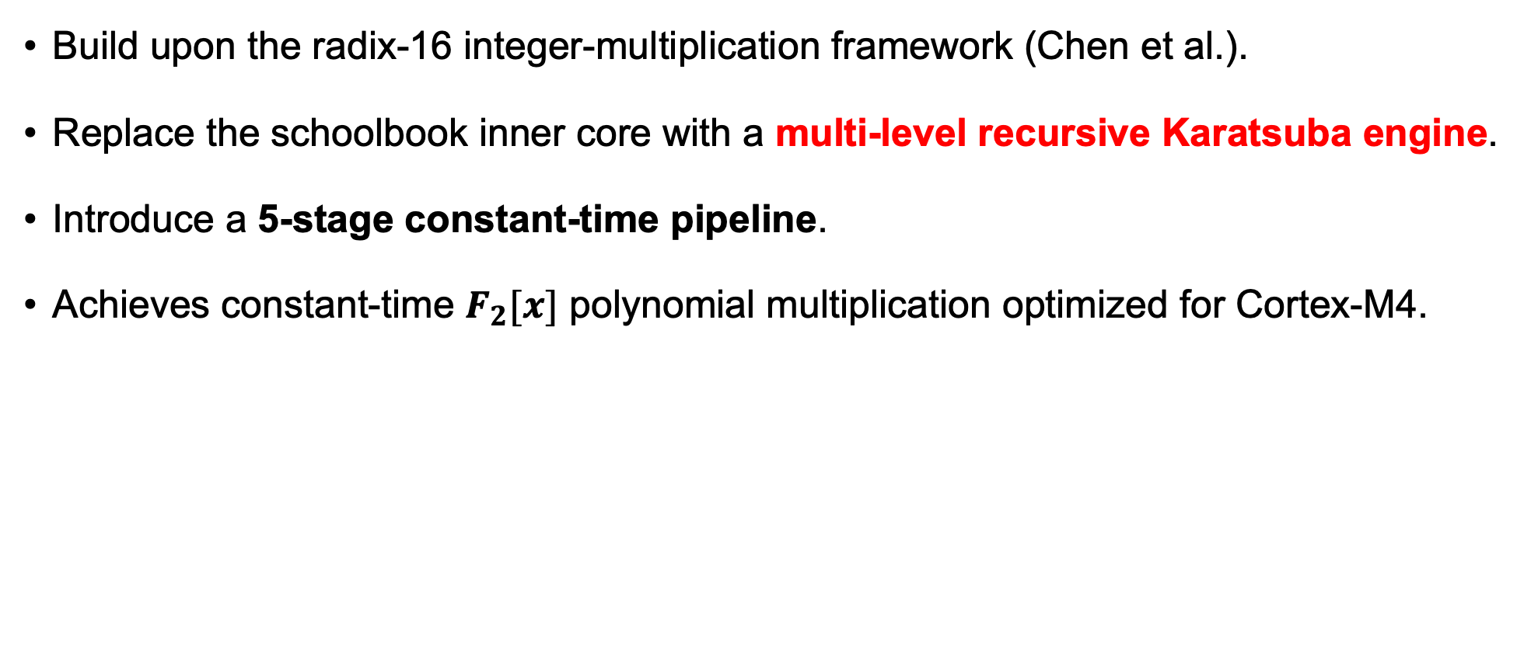
Proposed Method
Build upon the radix-16 integer-multiplication framework (Chen et al.).
Replace the schoolbook inner core with a multi-level recursive Karatsuba engine.
Introduce a 5-stage constant-time pipeline.
Achieves constant-time $F_{2}[x]$ polynomial multiplication optimized for Cortex-M4.

Slide 11
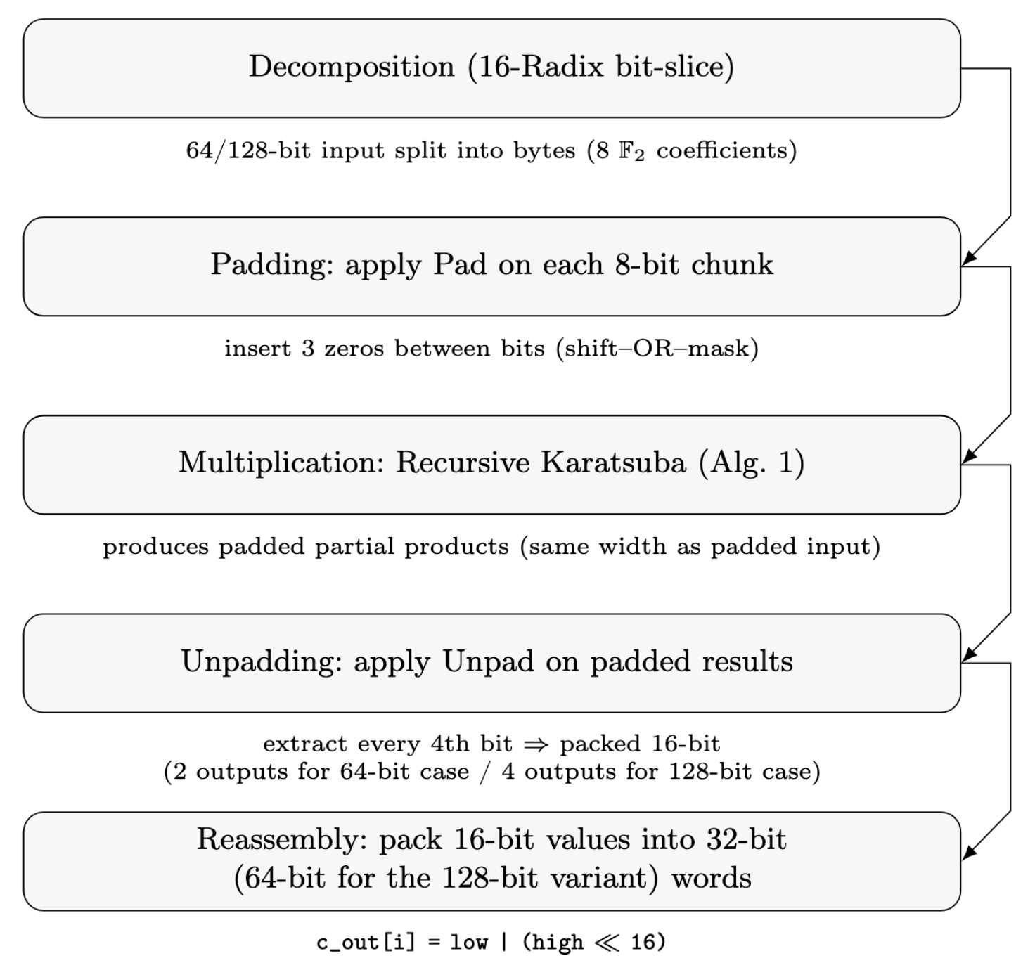
Proposed Method
Pipeline Overview
High-level 5-stage pipeline of the proposed multiplier.

Slide 12
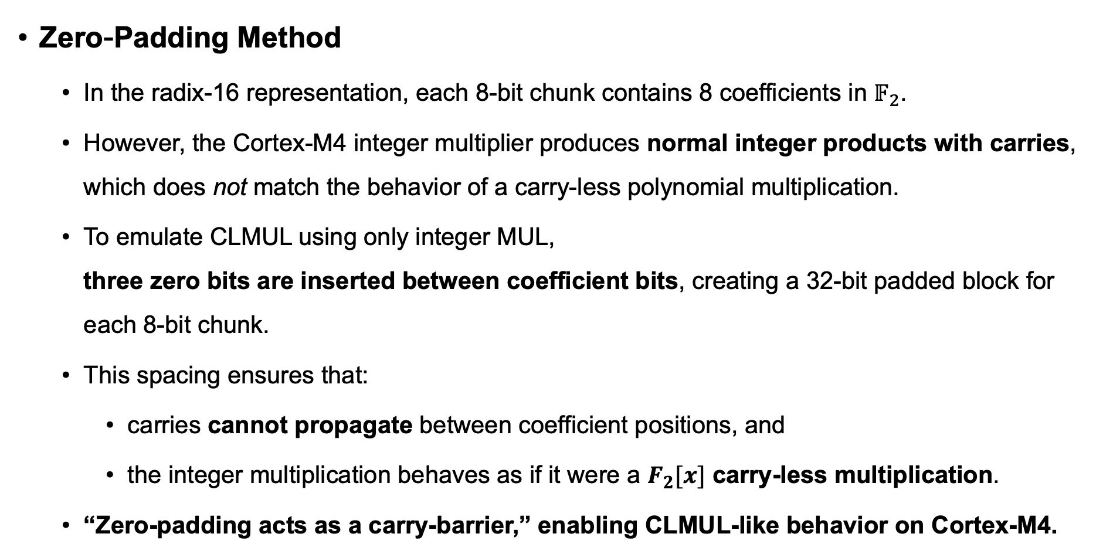
Proposed Method
Zero-Padding Method
In the radix-16 representation, each 8-bit chunk contains 8 coefficients in $𝔽_{2}$.
However, the Cortex-M4 integer multiplier produces normal integer products with carries, which does not match the behavior of a carry-less polynomial multiplication.
To emulate CLMUL using only integer MUL, three zero bits are inserted between coefficient bits, creating a 32-bit padded block for each 8-bit chunk.
This spacing ensures that:
carries cannot propagate between coefficient positions, and
the integer multiplication behaves as if it were a $F_{2}[x]$ carry-less multiplication.
“Zero-padding acts as a carry-barrier,” enabling CLMUL-like behavior on Cortex-M4.

Slide 13
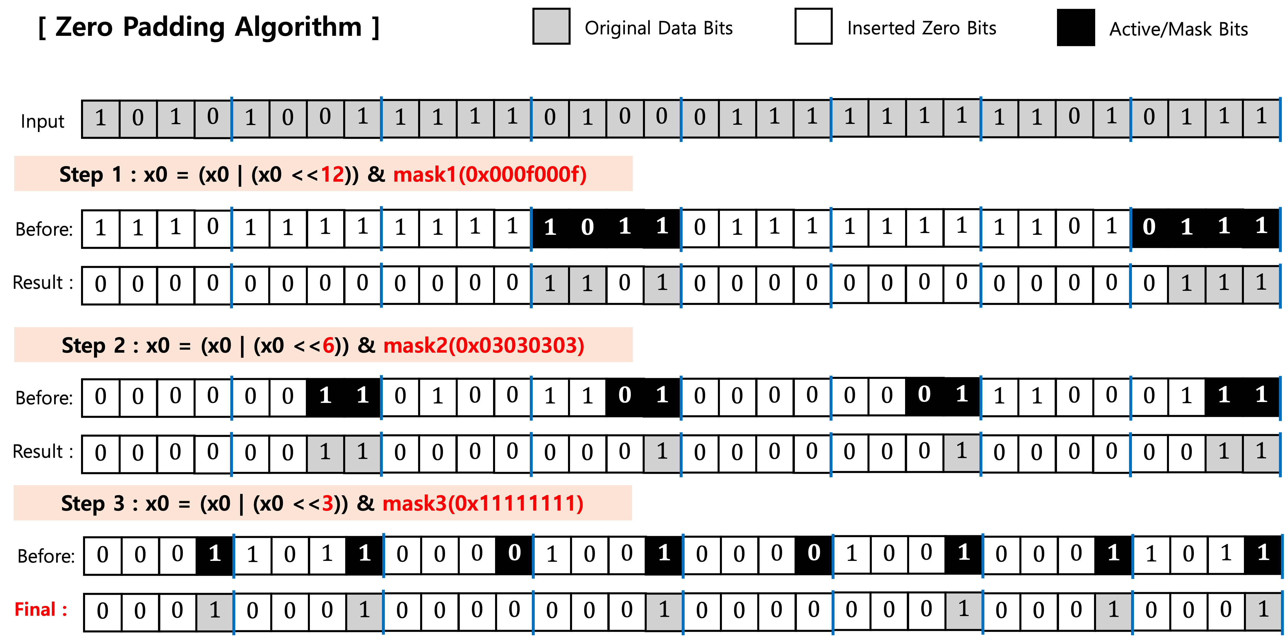
Proposed Method
Zero-Padding Method

Slide 14
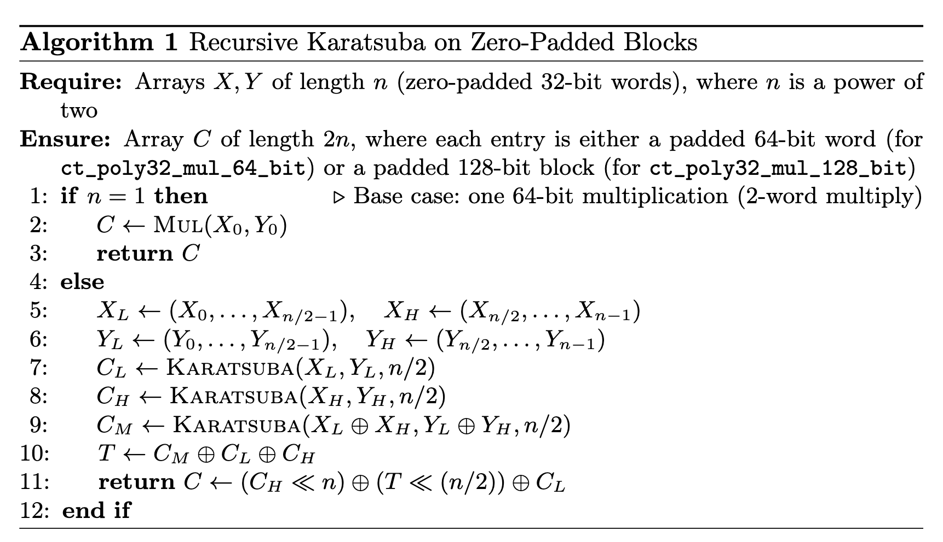
Proposed Method
Recursive Karatsuba Layers
Multi-level recursive Karatsuba replaces the original schoolbook inner core used in prior radix-16 multipliers (e.g., Chen et al.[3]).
Reduces the number of 32×32 integer multiplications while preserving strict constant-time execution.
Operates directly on zero-padded blocks, enabling efficient multiplication on wide bit-sliced operands.
Each recursive layer halves operand size, reducing the number of base multiplications.

Slide 15
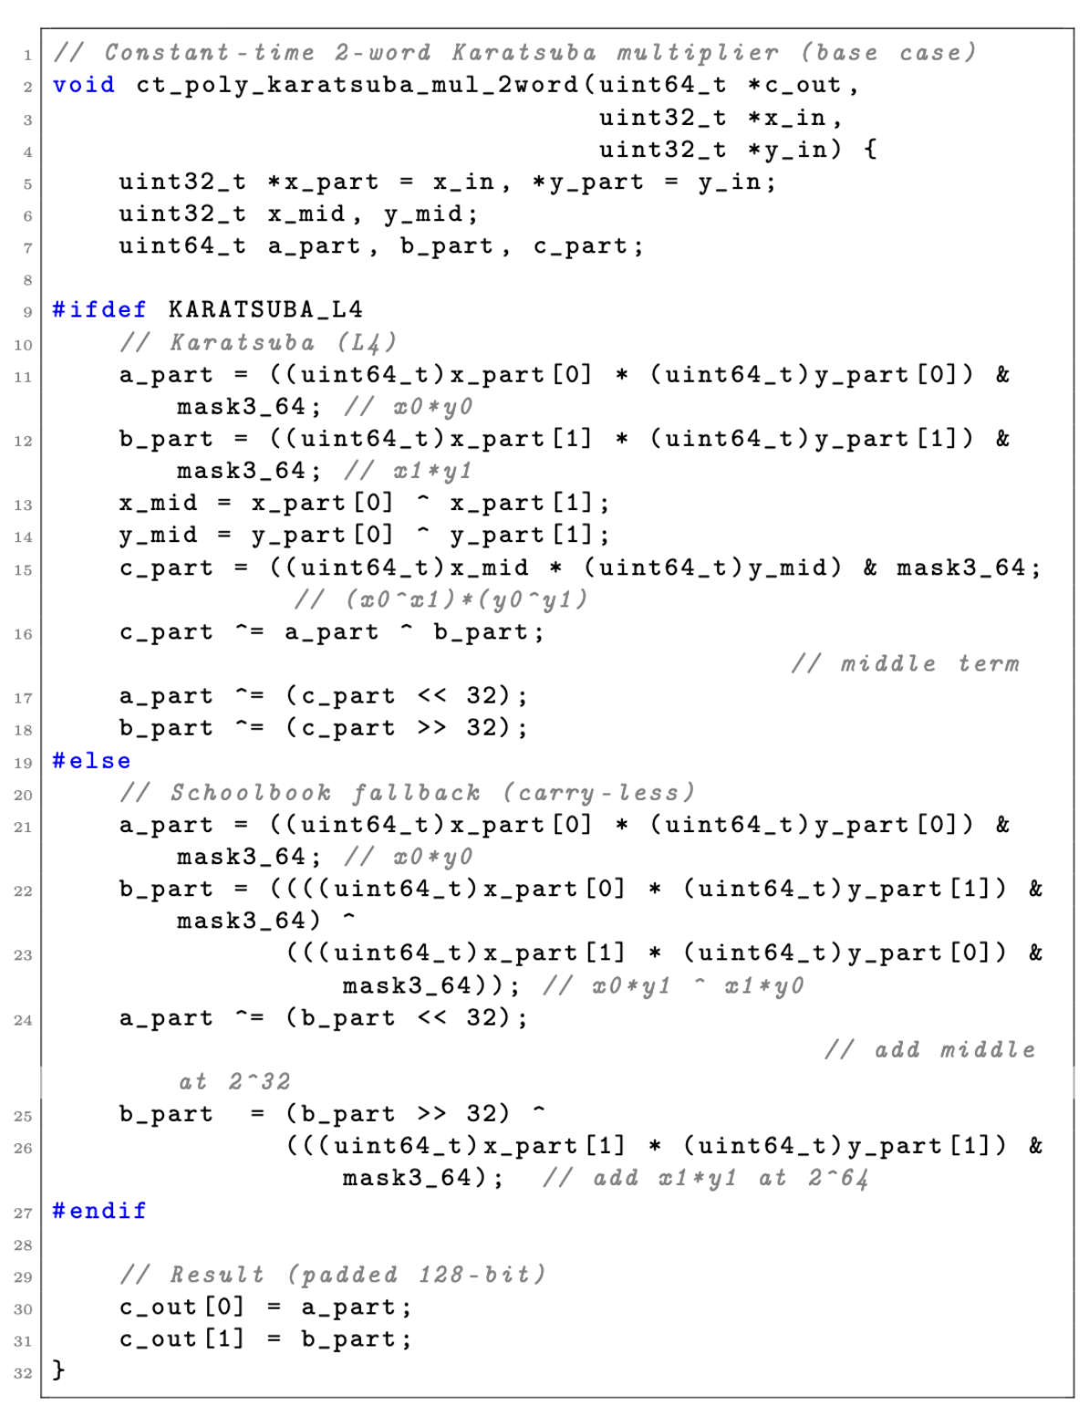
Proposed Method
Implemented entirely with 32-bit integer MUL and bit-mask operations, ensuring constant-time behavior.
The base case computes a padded 128-bit result from two padded 32-bit words.

Slide 16
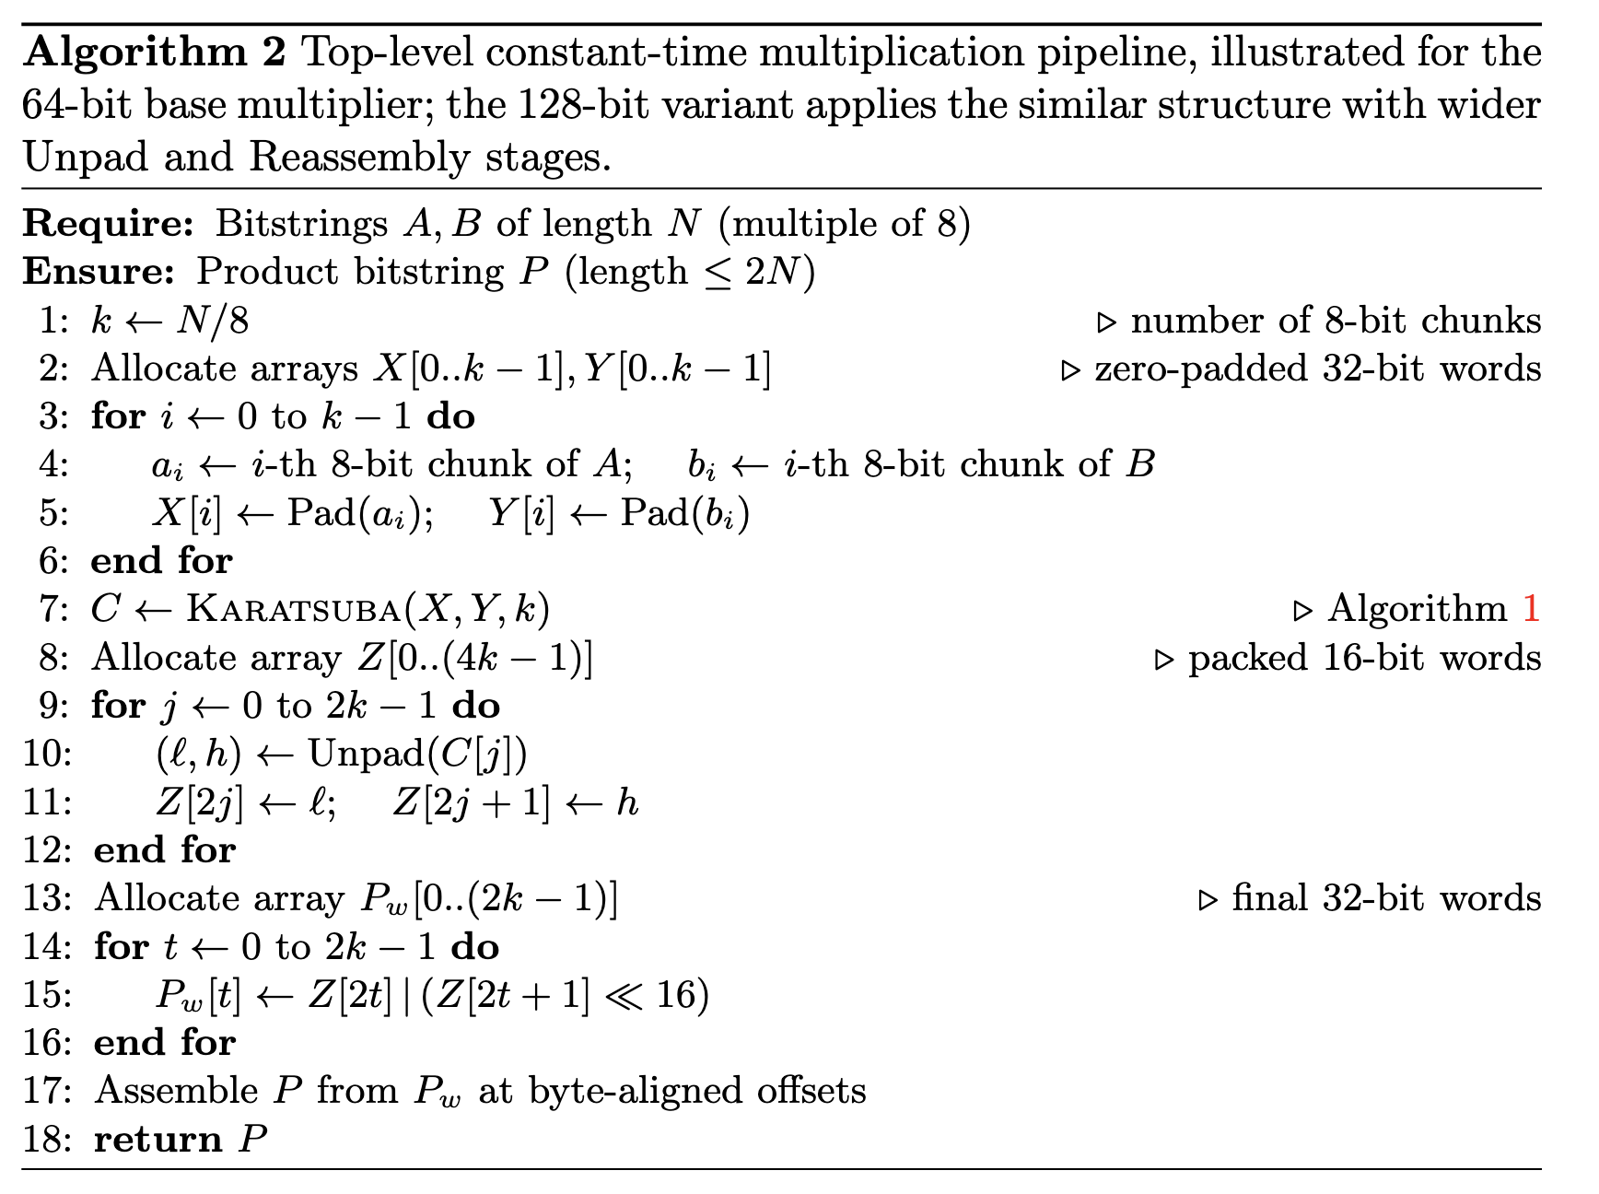
Proposed Method
Top-Level Multiplication Pipeline
The complete multiplication runs in strict constant time using only integer arithmetic and masking operations.
The 5-stage pipeline integrates all components:
Decomposition
Padding
Recursive Karatsuba
Unpadding
Reassembly
Enables high-speed polynomial multiplication for both 64-bit and 128-bit variants.
This structured pipeline guarantees constant-time behavior regardless of operand size.

Slide 17
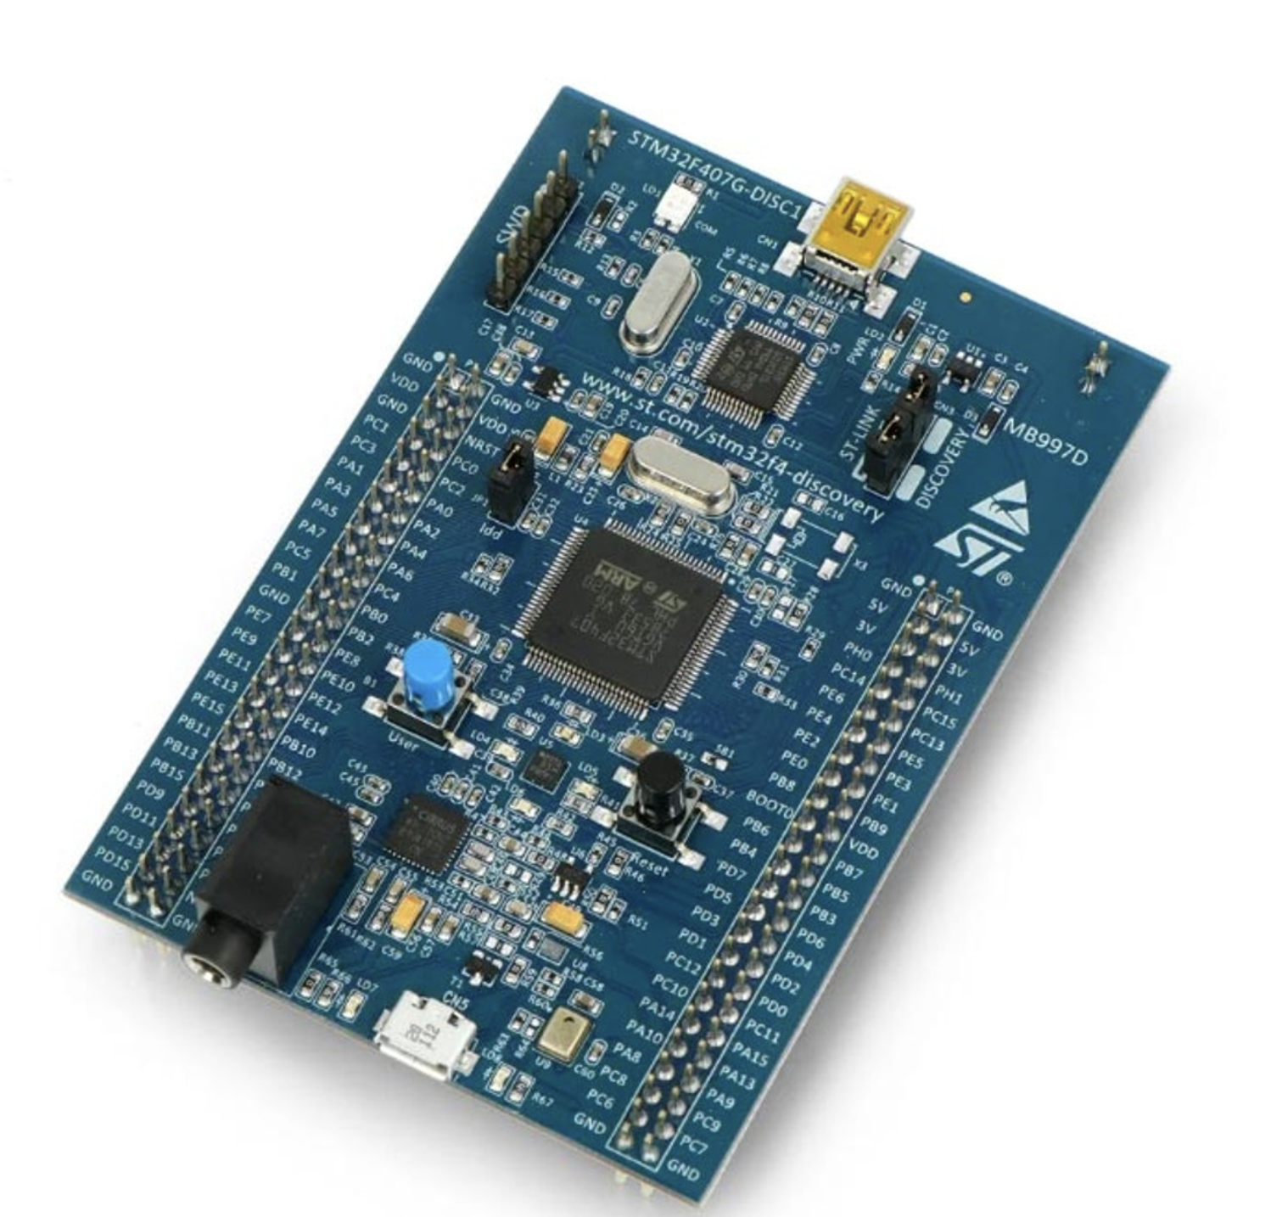
Evaluation
Implementation Environment
Platform: ARM Cortex-M4 (STM32F407, 168 MHz)
Compiler: ARM GCC 12.x with -O3 optimization
Measurement: Cycle-accurate timing using DWT cycle counter

Slide 18
Evaluation
Karatsuba level combinations and operation modes
Combination | Operation
Baseline | Baseline & Pure schoolbook multiplication
L3 only | Karatsuba applied at 4-word level; 2-word blocks remain schoolbook
L3+L4 | Karatsuba applied at both 4-word and 2-word levels
L4 only | Karatsuba applied at 2-word level only
L2 only | Karatsuba applied at 8-word level
L2+L3 | Recursive Karatsuba: 8→4-word
L2+L3+L4 | Full multi-level recursion: 8→4→2
L2+L4 | Top-level 8-word is schoolbook; only 2-word uses Karatsuba

Slide 19
Evaluation
Cycle counts of Karatsuba variants on Cortex-M4 (unit : clock cycles)
Variant | poly64_mul0 LD mul[1] | ct_poly64_mul1 Bernstein et al. [2] | Ct_poly32_mul_64_bit Our works[64-bit] | Ct_poly32_mul_128_bit Our works[128-bit]
Baseline | 421 | 1,643 | 1,135 | 3,400
L3 only | 421 | 1,641 | 1,171 | 3,392
L3+L4 | 421 | 1,641 | 1,207 | 3,407
L4 only | 421 | 1,641 | 1,128 | 3,422
L2+L3 | 421 | 1,643 | 1,175 | 3,383
L2+L3+L4 | 421 | 1,643 | 1,231 | 3,510
L2+L4 | 421 | 1,643 | 1,124 | 3,407

Slide 20
Evaluation
Relative performance difference (%) of Karatsuba variants
Variant | ct_poly64_mul1 Bernstein et al. [2] | poly64_mul0 LD mul[1]
Baseline | +30.92% | −169.60%
L3 only | +28.64% | −178.15%
L3+L4 | +26.45% | −186.70%
L4 only | +31.26% | −167.93%
L2+L3 | +28.48% | −179.10%
L2+L3+L4 | +25.08% | −192.40%
L2+L4 | +31.59% | −166.98%

Slide 21
Conclusion
We presented a high-speed, constant-time polynomial multiplier for Cortex-M4 using:
Radix-16 bit-slicing
zero-padding
multi-level recursive Karatsuba.
The 5-stage pipeline enables efficient multiplication for both 64-bit and 128-bit operands.
Our recursive Karatsuba variants achieve consistent speed-ups while strictly preserving constant-time execution.
In future work, we plan to apply the proposed multiplier to PQC (e.g., HQC, AIMer) on the Cortex-M4, and potentially extend it to symmetric-key operations such as GHASH acceleration.

Slide 22
Reference
[1] J. López and R. Dahab, “Fast multiplication on elliptic curves over gf (2m) without precomputation,” in International Workshop on Cryptographic Hardware and Embedded Systems, pp. 316–327, Springer, 1999.
[2] D. J. Bernstein. kpqc Google Group post, 2023. Code snippet: ct_poly64_mul1(kpqc post)
[3]Chen, Ming-Shing, and Tung Chou. "Classic McEliece on the ARM cortex-M4." IACR Transactions on Cryptographic Hardware and Embedded Systems (2021): 125-148.

